Slide 1

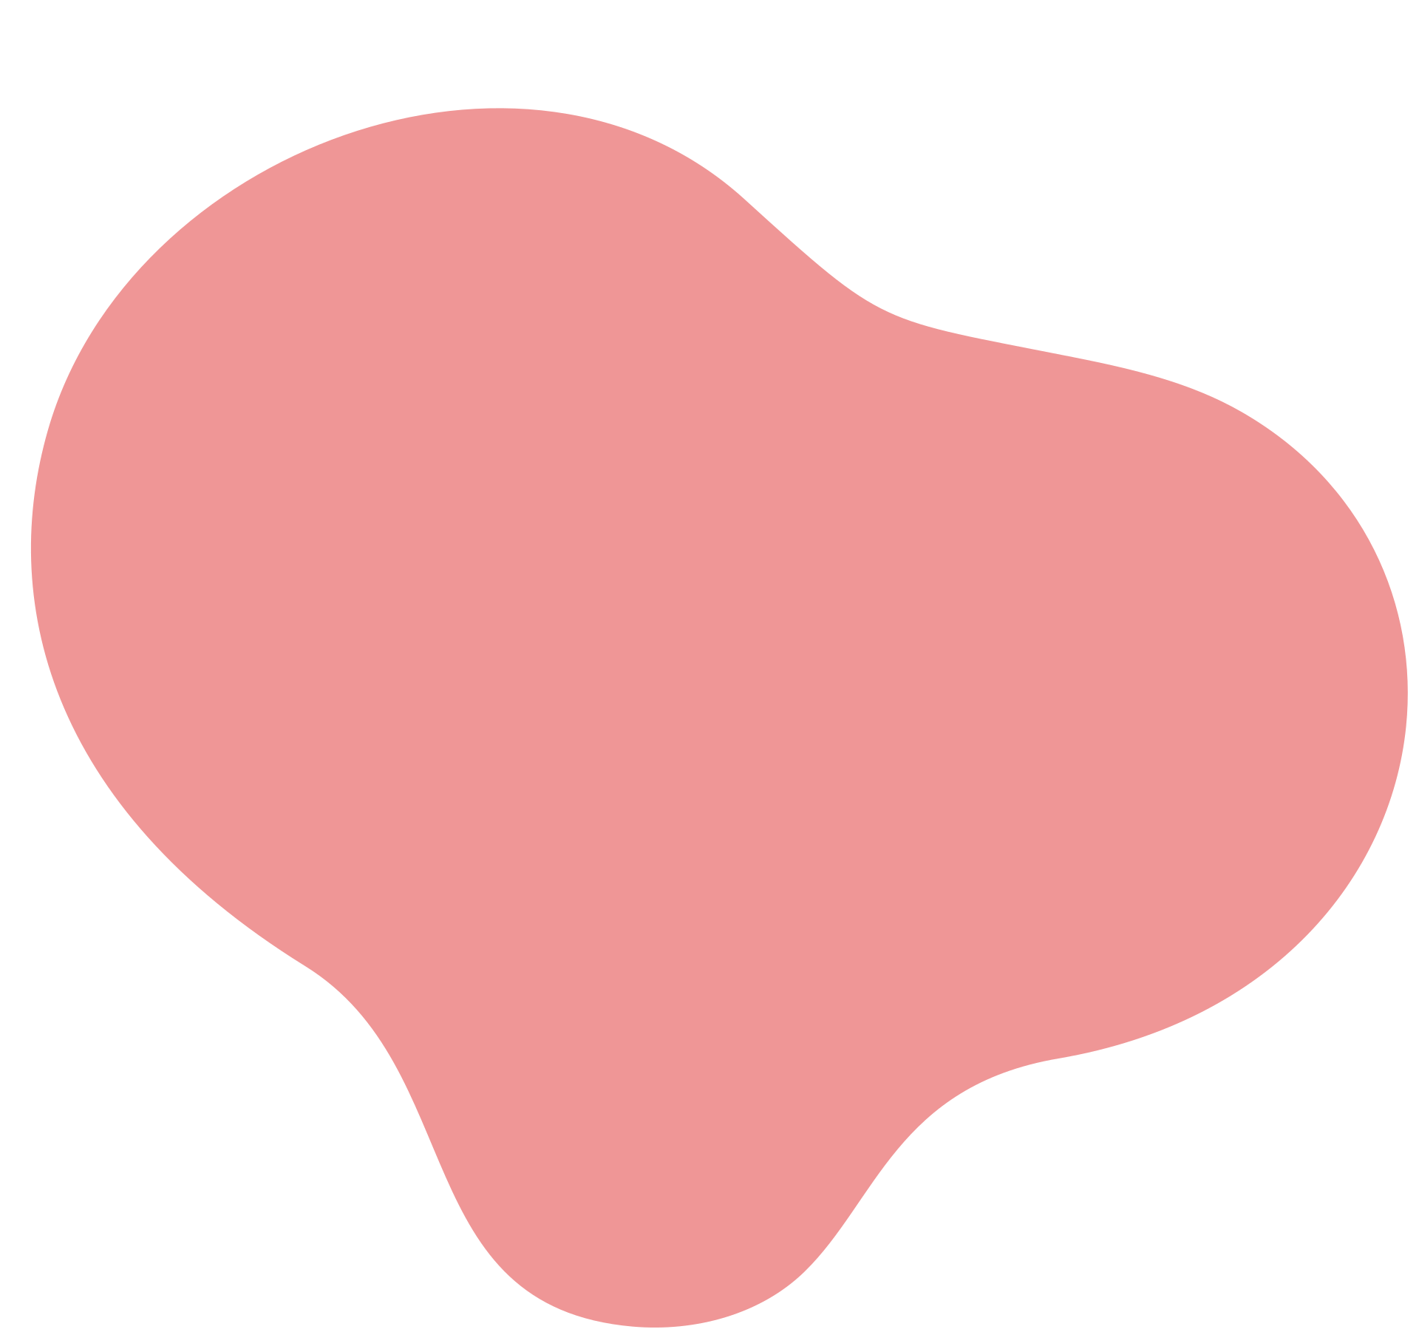

CARE BEGINS WITH CLARITY:
MATERNAL AND FOETAL HEALTH DIAGNOSTICS
IS ALL WELL
TEAM STRAW HAT PIRATES :
Deepanshu
Shivam
Mohini
Viva

Slide 2
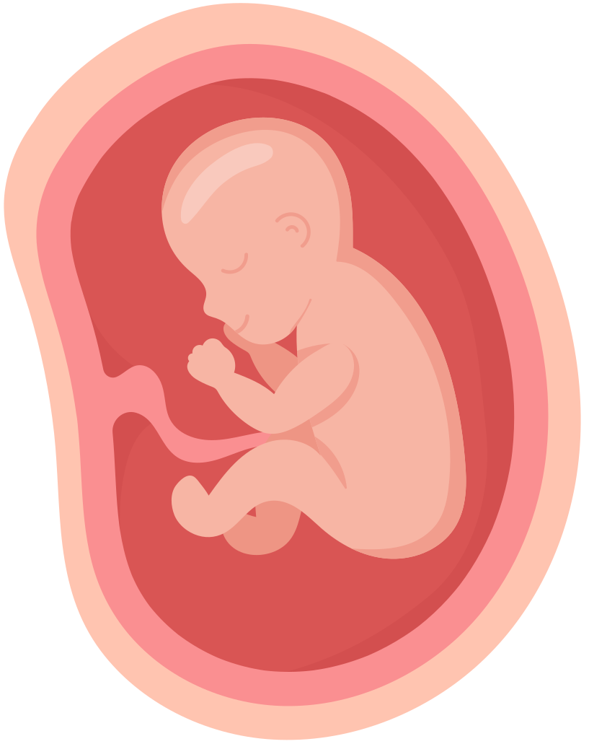
Problem Statement:
Enhancing Prenatal Care through Advanced Ultrasound Analysis
BACKGROUND
Traditional ultrasound analysis is often manual and subject to human error, requiring significant expertise which may not always be available.
PROBLEM
There is a need for an efficient, accurate, and accessible method to analyze ultrasound images to improve maternal and fetal health outcomes.

Slide 3

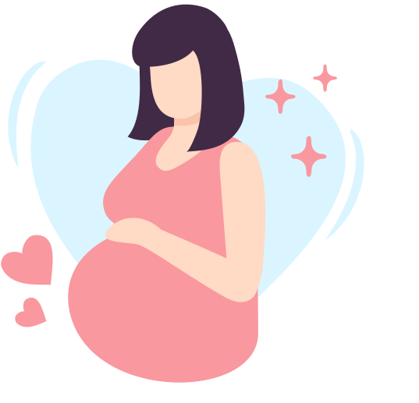
OBJECTIVE
To develop a platform using advanced machine learning algorithms for automated ultrasound image analysis, providing detailed insights into plane classification, maternal health, and fetal health.

Slide 4
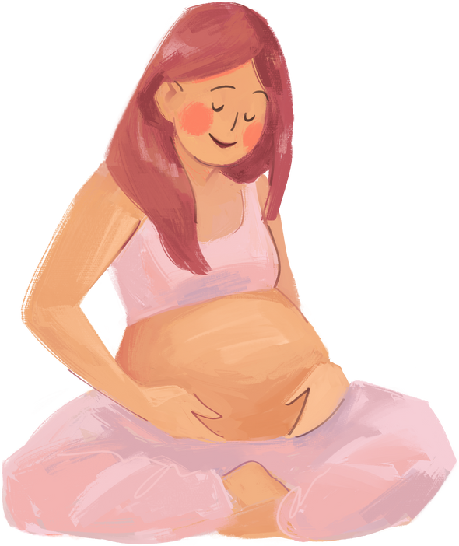
TECHNOLOGY USED
At its core lies the creation of a comprehensive dataset and a suite of deep learning models.
Comprising over 15,000 high-quality ultrasound images of a fetus at 23 weeks of gestation, this dataset is annotated with diagnostic planes, fetal biometric values, anatomical features, and bounding boxes for various fetal structures.
Python
Machine Learning
Flask

Slide 5


WHAT DOES OUR MODEL OFFER
Fetal orientation Model That can detect the structure of the foetus. --- Fetal thorax ,Maternal cervix , fetal brain, fetal femur.
Maternal Health ---- it can detect mother health – safe , Risk , Severe on the basis of Calories, trimester , Sleep time and Heart Rate

Slide 6



USE CASES
Portable ultrasound machines
Assist Radiologists
Medical assistance in remote areas
Give second opinion to specialists

Slide 7
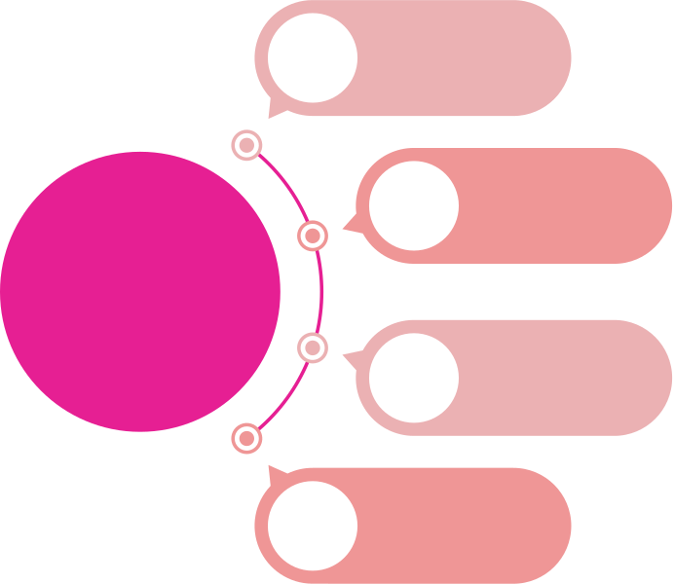
Integration in wearables
Integration
Integration with Other Imaging Modalities
FUTURE SCOPE
Real time analysis
Advanced Disease Detection

Slide 8
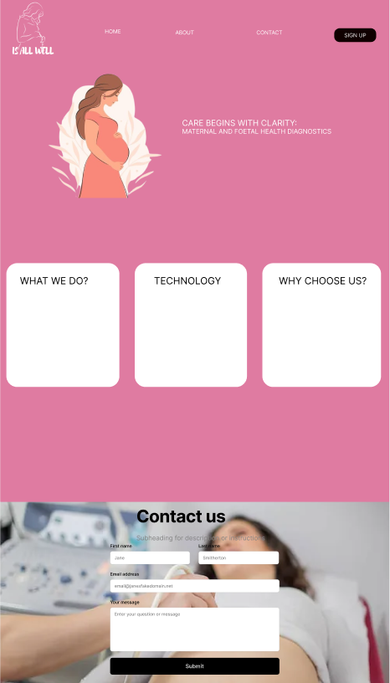
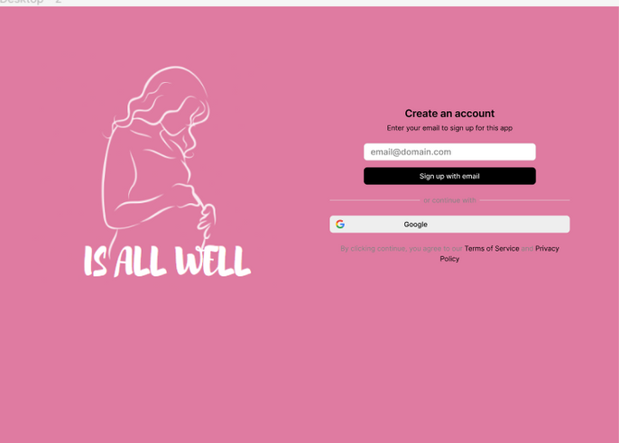
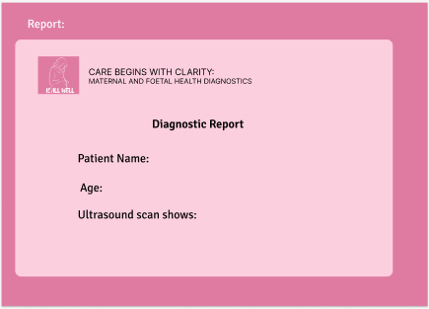
WEBSITE DESIGN

Slide 9
Thank You

